Slide 1
NURB Limb
A Motionbuilder FBBox() controller without the need to compile.

Slide 2
Why:
Motionbuilder has no adequate controller for curve like behavior (serpent or tentacle). Later releases of MB have splineIK which relies on beizer curves using control points, like in Photoshop or Illustrator. These are not ideal for animation. Earlier versions of MB have nothing at all.
Motionbuilder is increasingly our target DCC. Our cinematic suite (Theater Studio) is MB only.
More creature systems are coming our way and will gain a large benefit. Scorpion tails, Dragon neck and tails, Serpents/Snakes, Krakens. Anything that needs to slither.

Slide 3
The Prototype:
Uses Control Vertex instead of Control Points. Giving Maya like NURB behavior.
Skeleton nodes evenly distribute from 0 to 100% of the curves length.
Sin wave procedurally applies over MB system time and can be plotted onto the bones.
C++ FBSDK was used for math library.

Slide 4
The Plan:
Requirements from the system:
Version agnostic, (no compiled dll’s)
No python evaluation per tic.
Must use FBBox.
It should be able to handle any number of skeleton nodes in a chain as long as the number is greater than 3, upon which you should use limbIK instead.
It should be able to handle any amount of control handles beyond 4.
It should not care where the limb is positioned or oriented in the world.
It should setup a parent conditionally for a limb or serpent (CoM Root)
It should query the user for amount of Controls, and parent type.
Parent should have wave animatable parameters for Size, Speed, Length wired into the procedural wave system.
Requirements from the user:
Skeleton nodes need roughly evenly positioned from base to tip.
Rotation also needs even distribution.

Slide 5
Control and Curve creation
Early Development:
Algorithm complete for bone count, control count, distance and direction. The evaluation is based on the first and last node.
Here we have four controls evaluating correctly regardless of the bone count and limb length.

Slide 6
Procedural Integration
Sinewave with animatable parameters integrated into the curve, The controls are added as custom properties on the root control.
It’s based on Motionbuilder system time, which means you can scrub the timeline and plot the animation to your node chain.

Slide 7
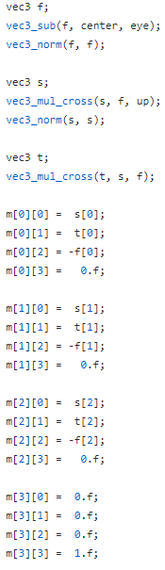
#lookAt
Needs:
An GLUT or GLM lookAt style behavior in the FBBox library.
A Lerp-able ‘up’ vector.
Conditions:
Version agnostic, (no compiled dll’s)
No python evaluation per tic.
Must use FBBox.
Problems:
No existing aim behavior in FBBox.
No matrix data type in FBBox.
No Quaternion data type in FBBox.

Slide 8
Why not just use the built in Aim constraint?
Because it’s not macro-able and doesn’t cleanly integrate with FBBox
Why use FBBox?:
It’s built in;
FBBox including all of it’s related classes and functions are built into the MB runtime. It has a decent math lib on hand for numbers and vectors, with some extra bells and whistles to deal with time, ramps, and rng.
It’s fast;
Motionbuilder is legendary for threading. In general it’s much faster than other DCC. Motionbuilder was threading for multi-processor workstations before the invention of multicore CPU’s. FFBox benefits from running on it’s own threads as needed.
It’s scriptable;
It’s easy to script and setup with python and exposed via FBConstraint.
It’s augmentable;
You have the ability to extend and create your own FBBox datatypes in python (at the expense of speed) or cpp (at the expense of portability) both of these fall outside our conditions but it should still be noted.
HOWEVER..!!!!!!....

Slide 9


NO MATRIX DATA TYPE
AND
NO QUATERNION DATA TYPE
FROM THE FBSDK
WTF!!!
Which means we can’t use the well known GLUT/GLM LookAt implementations without some smert hacks.

Slide 10
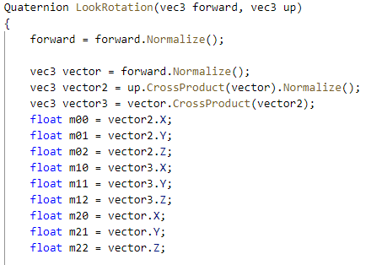
Step One:
Remove the matrix datatype and represent an equivalent with a cleanly named set of float variables.

Slide 11
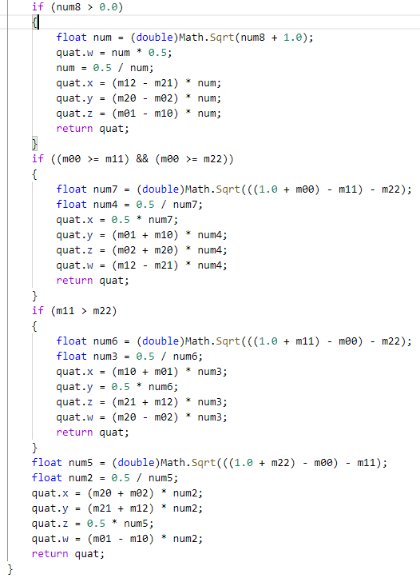
Step Two:
Perform the calculation and conversion from the makeshift rotation matrix to a quaternion.
Assuming we have a quaternion datatype ;P
And when we port this to FBBox it looks like:…….

Slide 12
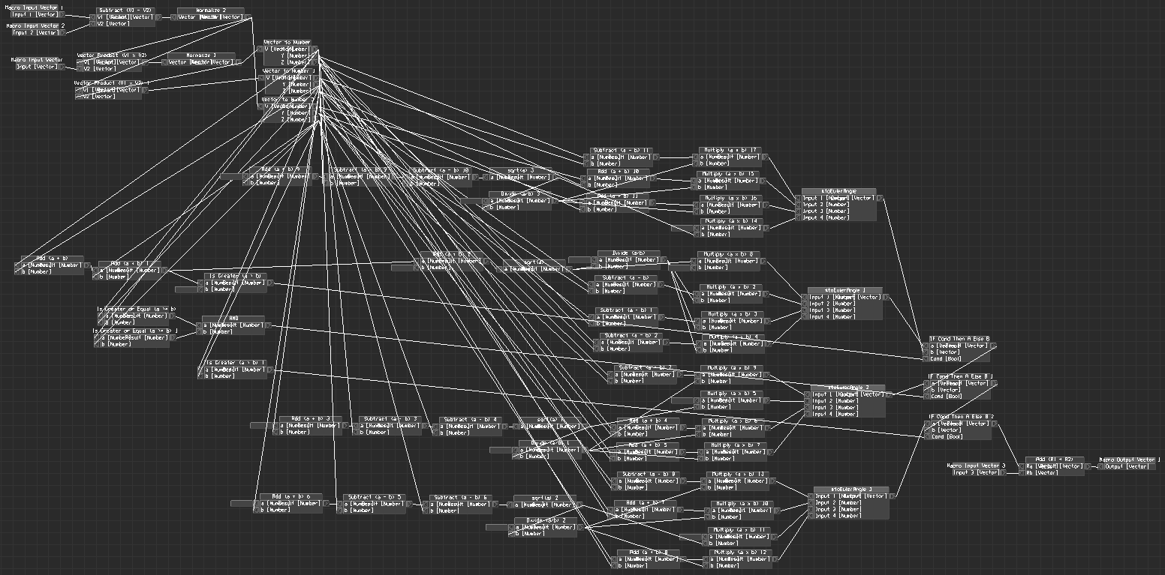
Reason number #### why I prefer a code block over a node graph.

Slide 13
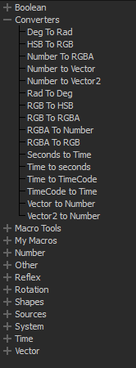
We are now left with a set of 4 floats that ‘could’ be a quaternion.
But we have no quaternion datatypes, let alone conversions to and from. Only Vectors and Numbers here people.
NO QUATERNIONS
Fortunately we’ve done all of our calculations. Which means we can cleanly convert to a Euler
But we’ll have to write our own.

Slide 14
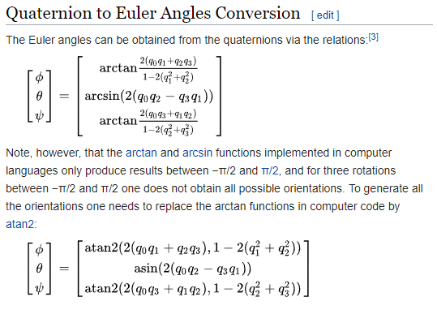
#toEulerAngle
The Algorithm
ROLL
PITCH
YAW

Slide 15
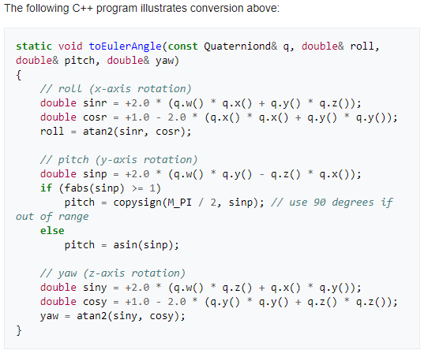
C++ representation.

Slide 16
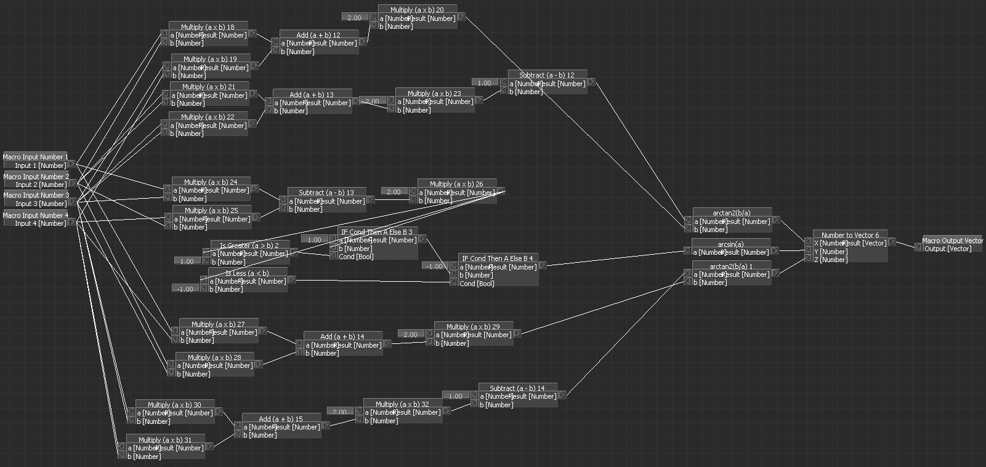
FBBox representation *yuck

Slide 17
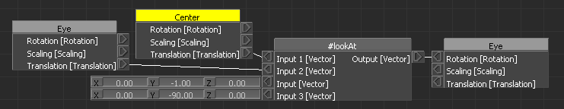
Congratulations, we have a lookAt in FBBox format.

